Slide 1


QR Guard – AI-Powered Security
MOBILECOMPUTING PROJECT
Supervised by:Eng.Rania

Slide 2
The Growing Threat of Phishing
RISKS OF URLS AND QR CODES:
Phishing attacks are increasing rapidly and target users through malicious URLs and QR codes.
These attacks can lead to:
🔓 Data theft
🦠 Malware
👤 Account compromise

Slide 3
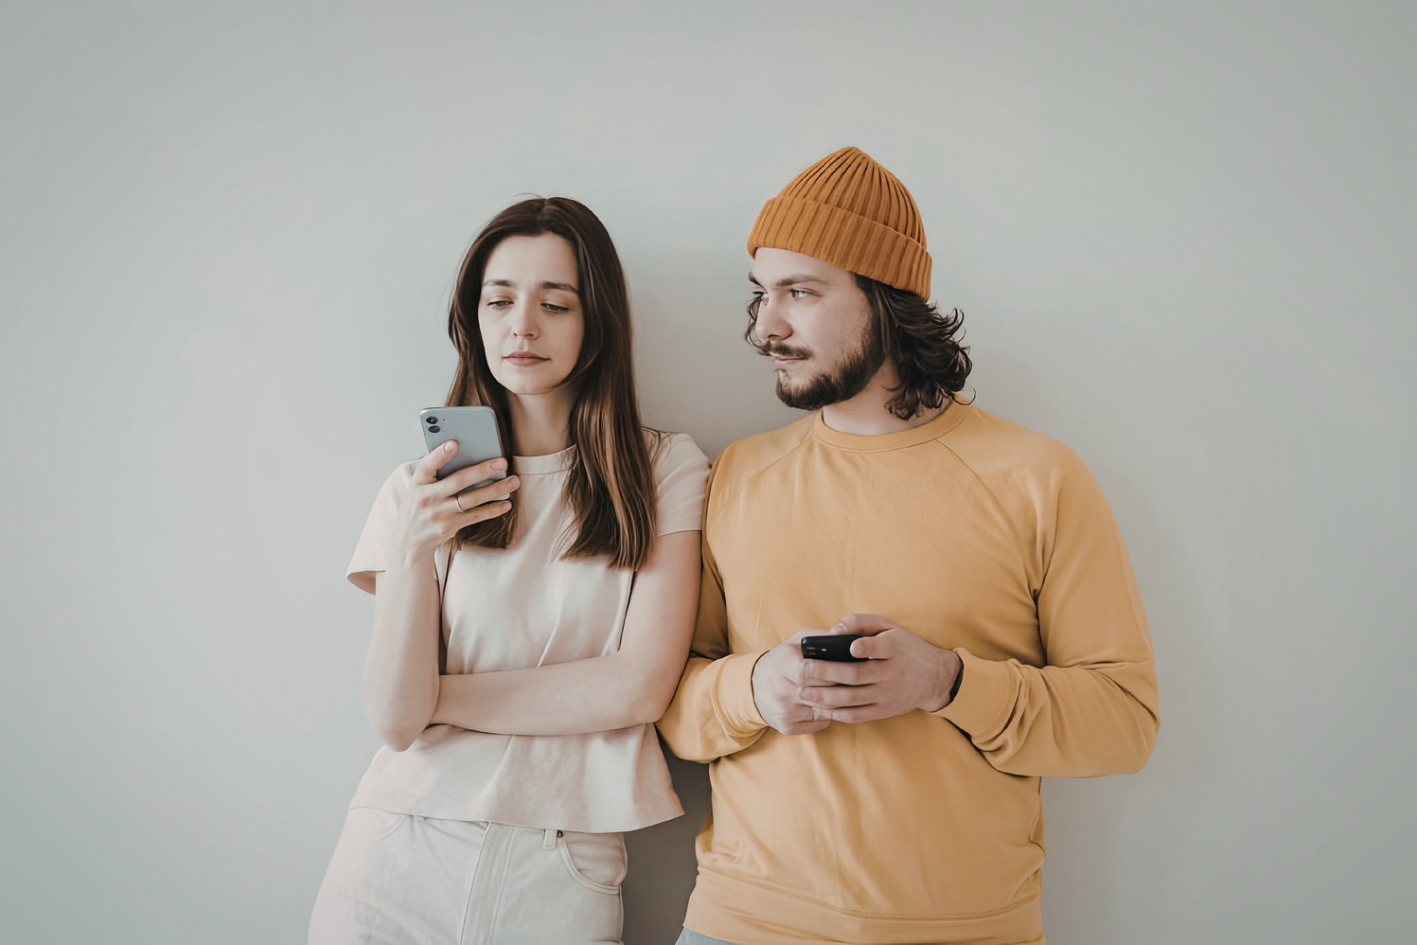

Understanding User Personas in Cybersecurity
👤 GENERAL USERS
🛡️CYBERSECURITY USERS
Require detailed, explainable results
Need confidence scores
Trust threat intelligence (e.g., VirusTotal)
Want technical breakdown of URLs
Need a simple interface
Focus on fast QR/URL scanning
Want clear Safe / Danger result
Prefer minimal technical details
Different users require different levels of detail, which is why QR Guard combines simplicity with advanced analysis.

Slide 4



Key Insights from User Research
FAST DECISION MAKING
RELIABLE DETECTION
EXPLAINABILITY
Users demand fast scanning for quick results
Users desire trusted detection to ensure safety
Users need explainable results to understand risks

Slide 5
Proposed Solution:
Hybrid Detection Architecture
🤖
ML MODEL
🌐 VIRUSTOTAL
THREAT INTELLIGENCE
EXTERNAL VERIFICATION
QR
GUARD
ENGINE
URL CLASSIFICATION
FAST PREDICTION
Combining both methods reduces false results and provides more reliable decisions.

Slide 6




Key Capabilities of QR Guard
CLASSIFICATION
CONFIDENCE
AI-driven analysis of URLs and QR codes to detect malicious content.
Provides a probability score indicating how certain the model is about its prediction.
EXPLANATION
SPEED
Explains why a URL is flagged for better user understanding and trust.
Ensures fast scanning for instant security decisions.

Slide 7
QR Guard Detection Pipeline
🔄 Steps of the Detection Process:
📷
QR Code Scan
🔗
URL
Extraction
🌐
Backend API Request
📊
Final Result (Safe /Dangerous)
🤖
ML Model Analysis
🛡️
VirusTotal Verification

Slide 8
Simple & Fast User Flow
📷 Scan
🤖 Analyze
📊 Result
The system extracts and analyzes the URL using AI and VirusTotal
User gets an instant result:
✅ Safe
❌ Dangerous
User scans the QR code
The process is designed to be fast, simple, and user-friendly.

Slide 9



Impact of QR Guard
🛡️ REDUCED PHISHING RISK
📢 INCREASED AWARENESS
📊 TRUSTED INSIGHTS
Helps users avoid malicious links and QR-based attacks.
Educates users about QR code threats and online risks.
Provides clear, explainable, and reliable security results.

Slide 10

Future Roadmap
🌐 Browser Extension
🔄 Real-Time Updates
🤖 Improved Model Accuracy
Scan URLs directly while browsing for better security.
Enhance ML performance using larger and more diverse datasets.
Continuously update threat intelligence for better detection.

Slide 11


Conclusion:
QR Guard is an intelligent security solution that helps users detect malicious URLs and QR codes before interacting with them.
By combining Machine Learning with VirusTotal, the system provides:
Fast detection
Trusted results
Clear explanations

Slide 12
Team members:
Eman Mohamed Hamed
Basma Mohamed Nagib
Mariam Maher Mohamed
Ahmed Ehab Mahmoud
Hassan Adel Hassan

Slide 13
Thank You

